Slide 1
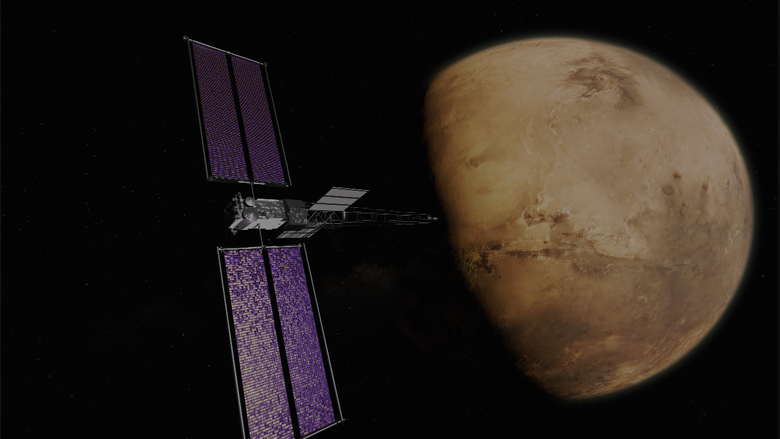

Material Characterization: Polyimides Alternative
Jean Kim, Advanced Polymeric Materials Branch Intern
Witold Fuchs, Ph.D Advanced Polymeric Materials Branch, M&P Technical Lead
Notes:
“Thermal Decomposition analysis of AEPS soft goods”

Slide 2
Each $ sign is roughly $500.
Polymer | Max Temp | Injection Mold | Relative Cost | Outgas Performance (TML%)
PEI | ~170C | YES | $/2 | Refer to August 4th Roxy(Alyssa)’s presentation for the up-to-date outgassing performance values
PPS | ~200C-220C | YES | $$
PEEK | ~250C | YES | $$
TPI | ~260C | YES | $$
PEKK | ~260C-300C | YES | $$$
Thermoset PI | ~315-340C | No (Composite/Press) | $$$$$$$$$$ (10)
Machined PI | ~300C (Short 480C) | No (Machined only) | $$$$$$$$$$$$$$$$$$ (18)
PBI | ~315C-400C (Short 500C) | No (Machined only) | $$$$$$$$$$$$$ (13)
*Acceptable TML% as per ASTM-E595 standard is 1.00%
Notes:
PEI: Polyetherimide
PPS: Polyphenylene Sulfide
PEEK: Polyetheretherketone
TPI: Thermoplastic Polyimide
- Short term high temperature resistance is quite high.
PEKK: Polyetherketoneketone
- Highest Temp tolerance that can be injection molded.
Thermoset PI: Thermoset Polyimides
Machined PI: Machined Polyimides
PBI: Polybenzimidazole
- Highest-performing engineering plastic in existence.

Slide 3
Sheet 12 in × 12 in × 0.5
Material | Price per Piece | Notes
PEI | $289.36
PPS | $1,003.05
PEEK | $722.00-772.26
TPI | N/A | Domestic vendor not available
PEKK | $1,000-$2,000+ | Domestic vendor not available Price may vary
Thermoset PI | $3,000~$7,000+ | Domestic vendor not available Price may vary
Machined PI | $6,000~$12,000 | Domestic vendor not available Price may vary
PBI | $4,500+ | Domestic vendor not available Price may vary

Slide 4
Granules/Pellets (Injection Molding)
Material | Price per Piece | Notes
PEI | N/A | Domestic vendor not available
PPS | $570.00/kg | Price may vary.
PEEK | $1380.00/kg
TPI | N/A | Domestic vendor not available (Request quote for exact pricing))
PEKK | $1650.00/kg | Price may vary.
Thermoset PI | X | Not injection moldable.
Machined PI | X | Not injection moldable.
PBI | X | Not injection moldable.

